Slide 1
Master Thesis Meeting
Yufang Wang / 王毓芳 (M.Sc.)
Wednesday, 12th Feb

Slide 2

Master Thesis proposal writing;
Data question;
Methodology question;

Slide 3
Master Thesis proposal writing;
Red part is what I have filled (need to be verified);
Green part needs to be filled by you.

Slide 4
Data question
Event of interest: graft loss?
Do I only need to focus on bolded variables?
Some variables have a lot of categories.
Missing data issues?

Slide 5
Methodolgy question
Event of interest: graft loss?
Do I only need to focus on bolded variables?
Some variables have a lot of categories.
Missing data issues?

Slide 6
IMPROVE project: to-be-measured items for WP4
Qualitative results
Quantitative results
Quantitative results
Interviews for needs, preferences and compensatory behaviour
in daily life
Questionnaire:
Mini Nutritional Assessment (MNA)
30-item MMSE measurements
Subjective health
Depression scale
Social integration and social isolation
Pre-defined tasks of daily living
(e.g., getting in/out of bed,
walking to the kitchen, toileting,
and preparing meals).
Compensatory strategies
Compensatory strategies
psychology
locomotion
cognition
sensory
cognition
psychology
cognition
vitality
sensory
Fatigue
Body movement
Questionnaire score
Energy
Blood pressure
…
Heart rate
Notes:
Cognitive impairment, as measured by the 30-item MMSE measure (Folstein, Folstein, & McHugh, 1975), was also considered a functional limitation variable. Because our original criteria excluded those individuals suffering from dementia, the distribution of MMSE scores was highly skewed (i.e., showing a ceiling effect), with only about 10% of participants having possible cognitive impairment. Consequently, we decided to categorize participants as either not cognitively impaired (0) or possibly cognitively impaired (1). The cut-off score for categorizing participants into these groups was 23.
Psychosocial variables and internal resources.—Four psychosocial measures were used that measured subjective health, depression, social integration, and social isolation. For subjective health, four questions were asked that related to (a) how the participants appraised their general health (good, average, or bad), (b) how they rated their health compared with 2 years ago (better, same, worse), (c) how they would rate their health compared with others the same age (better, same, worse), and (d) whether they thought health prevented them from doing things they liked. These items were subjected to a principal components analysis that indicated the presence of one component that explained 51% of the total variance. A summary score was created by calculating the mean among the four items. Higher scores indicated better self-reported health. Cronbach’s alpha for this measure was .68. Depression was measured by the Center for Epidemiologic Studies—Depression Scale (CES-D; Radloff, 1977). The instrument had 20 items rated along a 4-point Likert scale that measured the participant’s current level of depressive symptomatology. A total depression score was calculated with higher scores indicating more depressive symptoms (Cronbach’s a 5 .84). Because the distribution of the scale was highly skewed, a dichotomous variable indicating depressed (1) or not depressed (0) was calculated using the cut-off score of 16. Feelings of social isolation were measured by the sum of three items that asked the degree to which the participants felt lonely, lacked company, or felt abandoned. The scale was rated along a 4-point Likert scale ranging from not at all (0) to nearly always (3). A higher score indicated higher feelings of social isolation (Cronbach’s a 5 .66). Feelings of social integration consisted of the sum of two items measuring whether the respondent felt he or she had friends to talk with and felt a part of a set of friends. This scale was rated similarly to social isolation. A higher score reflected higher feelings of social integration (Cronbach’s a 5 .81).
The disablement process in very late life: A study of the Oldest-Old in Sweden

Slide 7
IMPROVE project: experimental procedure for WP4
Procedure:
Screening & inviting participants
Interview
Questionnaire
Pre-defined tasks of daily living
Needs/preference
Compensatory behaviour
Mini Nutritional Assessment (MNA) for vitality
Self-reported sensory
Three-word recall for cognition capacity.
Self-reported psychological well-being, stress, and anxiety.
Getting in/out of bed
Walking to the kitchen
Toileting
Preparing meals
Screen IC for people 65+ years old
30 + people probable decrease vs. not decreased in IC.
Exclusive criteria
Video recording + IMU + ECG + PPG + EDA + respiratory signals + fitness band
Non stimulus-related vs. Stimulus-related
Notes:
Exclusive criteria:
(1) mentally not being able to sign the informed consent form;
(2)severe mobility disorders making them unable to walk;
(3) Not speaking Dutch.
Recording (in the whole procedure): Video recording + Inertial measurement unit (IMU) +
electrocardiography (ECG) + photoplethysmogram (PPG) +
electrodermal activity (EDA) + respiratory signals +
oxgyen analyzer
Preparing meals was divided into two tasks: (1) preparing a small
meal and (2) grabbing something to drink
Participant are allowed to perform all tasks in their own order and at their own pace.

Slide 8
IMPROVE project: interesting variables in pre-defined tasks for WP4
Examples of getting in and out of bed: focus on locomotion
Stand still near bed
Get into the bed
Lie down
Get out of bed
Behavioral measurements (obtained from video recording under sub-tasks):
ability (Yes/No); (2) total time, number of transfers, time spent sitting, standing;
(3) compensatory strategies.
Physiological measurements:
(1) IMU: features related to body movement, e.g., linear acceleration, angular velocity, rotation velocity,
COG as body balance, time onset for each stage of walking; stride and step length, permutation entropy
as smooth metric;
(2) ECG: heart health related features (e.g., heart rate, arrhythmias);
(3) EDA: features related to sympathetic nervous activity (e.g., amplitudes of the non-specific skin
conduct/potential responses, turning points of the non-specific skin potential responses relative to another peak);
(4) PPG: vascular related features (e.g., stiffness index, reflection index, crest time, crest time ration);
(5) Respiratory Signals: fatigue-related features (e.g., respiratory rate, tidal volume, respiratory muscle activity).
Notes:
The number of transfers was calculated by counting how many transfers were performed
during a task.
Transfers included any activity in which a participant went from sit to stand,
stand to sit, stand to lie, lie to stand, sit to lie, or lie to sit. When participants were able to
get in or out of bed in one smooth movement, one transfer was counted (stand to lie or lie
to stand). When participants needed to sit first before they lay down or before they got up,
we counted two transfers: stand to sit and sit to lie or vice versa.
Video recording + Inertial measurement unit (IMU) +
electrocardiography (ECG) + photoplethysmogram (PPG) +
electrodermal activity (EDA) + respiratory signals +
oxgyen analyzer
Inertial Measurement Unit (IMU): Measures motion and orientation using accelerometers and gyroscopes. Useful for tracking physical activity, gait analysis, and detecting falls1
Temporal Variables:
Stride Time: The time taken to complete one full gait cycle.
Stance Time: The duration of the stance phase when the foot is in contact with the ground.
Swing Time: The duration of the swing phase when the foot is off the ground.
Cadence: The number of steps taken per minute1
.
Spatial Variables:
Stride Length: The distance covered in one full gait cycle.
Step Length: The distance between successive points of initial contact of the opposite feet1
.
Kinematic Variables:
Linear Acceleration: Measures the acceleration of the body segments.
Angular Velocity: Measures the rotational speed of the body segments.
Joint Angles: The angles of the joints during different phases of the gait cycle2
.
Event Detection:
Heel Strike (Foot-Strike): The moment the heel contacts the ground.
Toe Off (Foot-Off): The moment the toe leaves the ground1
.
Smoothness Metrics:
SPARC (Spectral Arc Length): A measure of the smoothness of the gait cycle.
PM (Permutation Entropy): Another measure of smoothness.
LDLJ (Log Dimensionless Jerk): A metric for assessing the smoothness of motion2
most balance-monitoring tools measure the
projection of an individual COG on a static platform with
embedded force-plate sensors, which accounts for only the
downward force, with contributions from lateral movements to
shift COG inferred indirectly.
Reviews on Various Inertial Measurement Unit (IMU) Sensor Applications

Slide 9
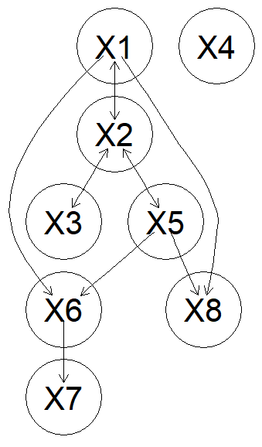
IMPROVE project: Statistical analysis plan to answer question a) for WP4
a). Selection of appropriate digital monitors for large quantitative studies.
Propensity score method
(for binary confound)
Mixed effect models
Adjustment set of variables
in causal inference
Backdoor/b adjustment criteria
Validate the causal
relationship
Causal structure learning for potential
causal relationship
Causal structure learning & causal inference on different dataset
Cross validation as an alternative

Slide 10
IMPROVE project: Statistical analysis plan to answer question b) for WP4
b). Identification of needs and preferences and compensatory behavior.
Time
Propensity score method
(for binary confound)
Mixed effect models
Adjustment set of variables
in causal inference
Backdoor/b adjustment criteria
Validate the causal
relationship
Variable set
Causal structure learning & causal inference on different dataset
Cross validation as an alternative

Slide 11
IMPROVE project: Statistical analysis plan to answer question c) for WP4
c). Development of questionnaires to measures person-environment fit.
Propensity score method
(for binary confound)
Mixed effect models
Adjustment set of variables
in causal inference
Backdoor/b adjustment criteria
Validate the causal
relationship
Causal structure learning for potential
causal relationship
Causal structure learning & causal inference on different dataset
Cross validation as an alternative

Slide 12
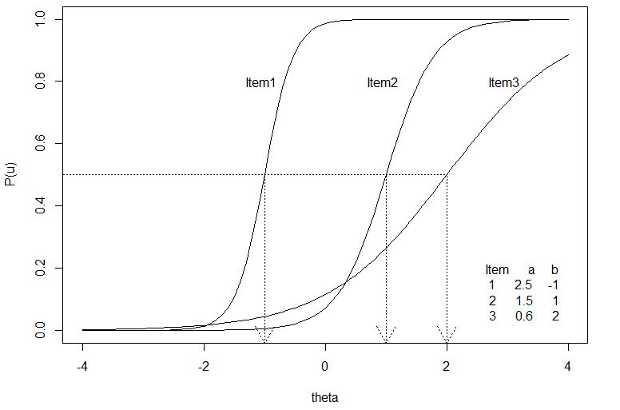
Collaboration in WP4
1. Questionnaire development:
Classic test theory to promise the agreement of questions
Item response theory to promise that people having decreased IC is highly detected.
2. Experimental design for hypothesis regarding persons with lower IC may have good FA when there
is a good person-environmental fit:
determining the mini adjustment set. .
3. And others…
Notes:
Add the selection bias picture

Slide 13
To-be-addressed questions
Time –series data: event-related vs. dynamic vs. stationary
Number of participants
Medication use to be considered?

Slide 14
Brief ideas for HealthyW8 project

Slide 15
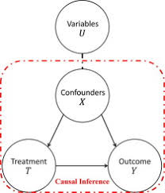
HealthyW8 project: Statistical analysis plan for WP4
Qualitative data: compensatory strategies
Quantitative data: (1) variables are correlated; (2) more variables than number of participants
Preliminary statistical plan: Cause structure learning + mixed effect model

Slide 16
Q&A

Slide 17
Thank you for your attention!

Slide 18
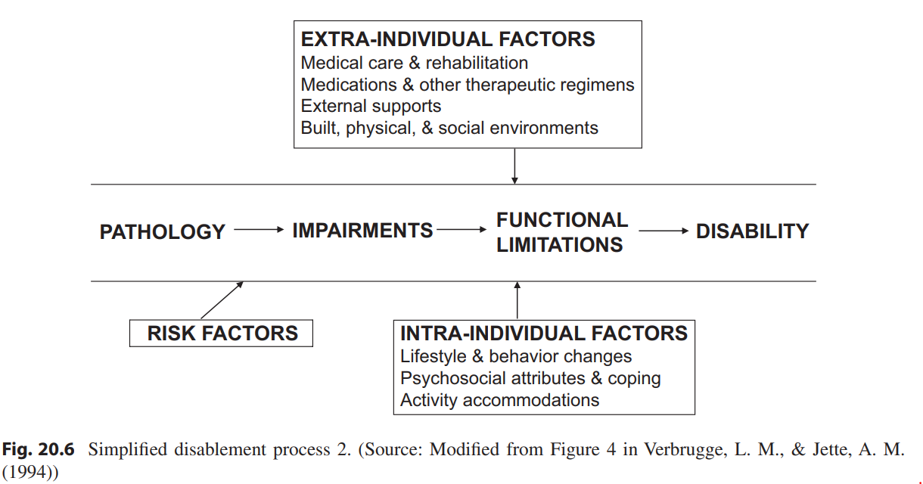
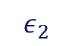


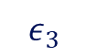

IMPROVE project: IC measurements
cognition
$$ε_{1}$$
psychology
$$ε_{2}$$
Functional ability (FA)
Intrinsic capacity (IC)
sensory
$$ε_{3}$$
vitality
$$ε_{4}$$
Compensatory strategies
locomotion
$$ε_{5}$$
Simplified to One-factor model
Latent variable
Observed variable
Noise

Slide 19
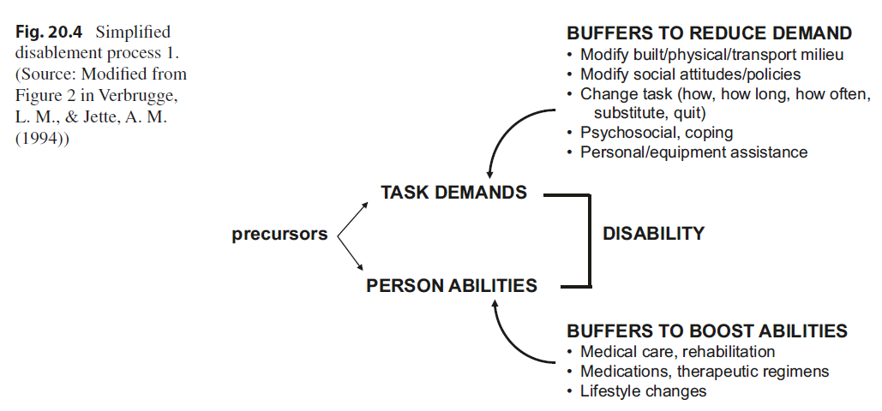
IMPROVE project: Statistical analysis plan for WP4
Qualitative data: compensatory strategies
Quantitative data: (1) variables are correlated; (2) more variables than number of participants
Preliminary statistical plan: Cause structure learning + mixed effect model

Slide 20
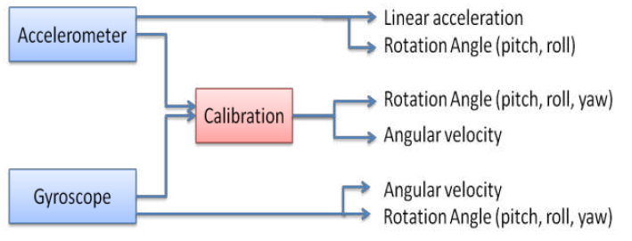
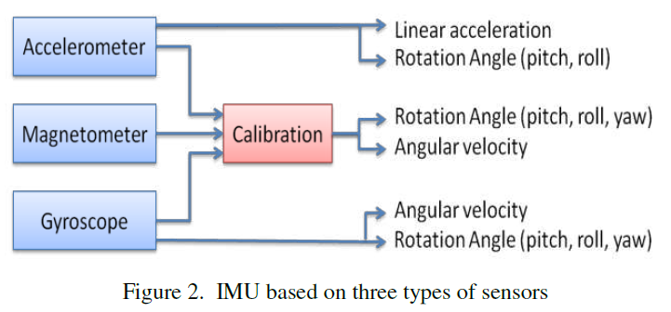
Measurements of Inertial measurement unit (IMU)
Norhafizan et al., 2013

Slide 21
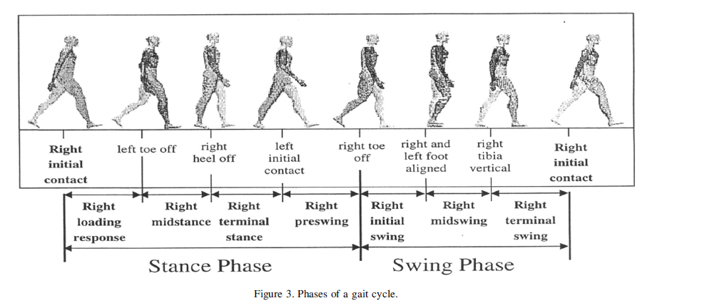
Inertial measurement unit (IMU) for human gait /body movement monitoring
Norhafizan et al., 2013
Notes:
Temporal Variables:
Stride Time: The time taken to complete one full gait cycle.
Stance Time: The duration of the stance phase when the foot is in contact with the ground.
Swing Time: The duration of the swing phase when the foot is off the ground.
Cadence: The number of steps taken per minute1
.
Spatial Variables:
Stride Length: The distance covered in one full gait cycle.
Step Length: The distance between successive points of initial contact of the opposite feet1
.
Kinematic Variables:
Linear Acceleration: Measures the acceleration of the body segments.
Angular Velocity: Measures the rotational speed of the body segments.
Joint Angles: The angles of the joints during different phases of the gait cycle2
.
Event Detection:
Heel Strike (Foot-Strike): The moment the heel contacts the ground.
Toe Off (Foot-Off): The moment the toe leaves the ground1
.
Smoothness Metrics:
SPARC (Spectral Arc Length): A measure of the smoothness of the gait cycle.
PM (Permutation Entropy): Another measure of smoothness.

Slide 22
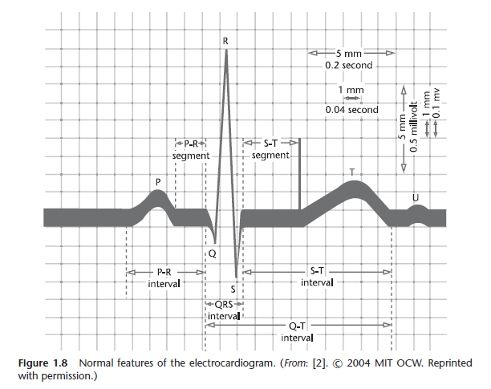
Electrocardiography (ECG) measurement
Notes:
Electrocardiography (ECG): Records the electrical activity of the heart. Essential for monitoring heart rate, detecting arrhythmias, and assessing overall cardiac health2

Slide 23
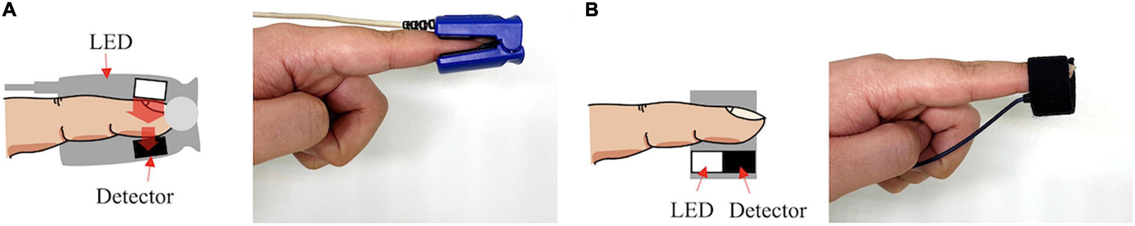
Photoplethysmogram (PPG) for
Notes:
In addition to basic heart rate estimation, PPG is used for
1. blood pressure estimation;
2. vascular aging assessment;
3. Arterial fibrillation
4. Peripheral vascular disease assessment;
5. Surgical and postoperative pain assessment;
6. hemodynamic parameter estimation such as cardiac output
7. Stroke volume;
8. sleep monitoring including apnea and hypopnea detection;
9. emotional recognition

Slide 24
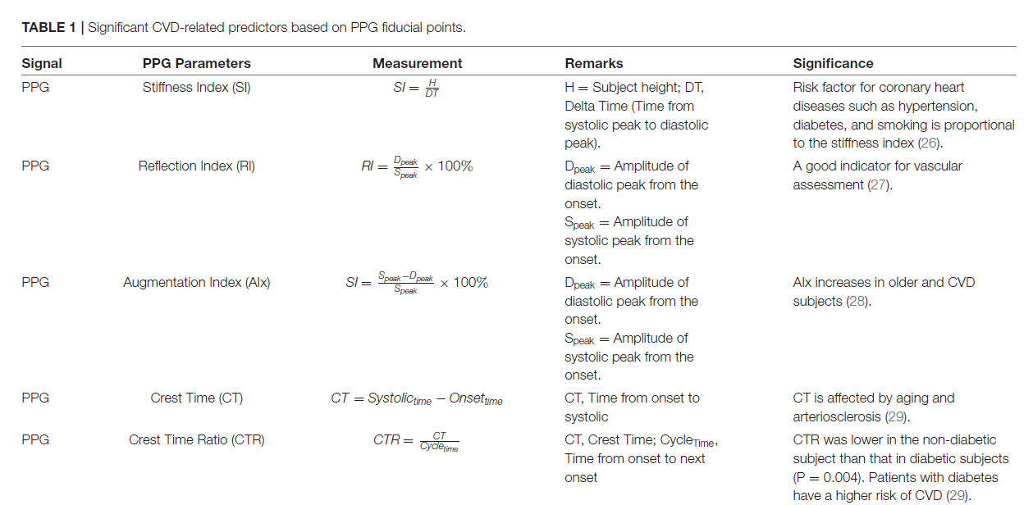
Photoplethysmogram (PPG) for cardiovascular monitoring
Notes:
Photoplethysmogram (PPG): Measures blood volume changes in the microvascular bed of tissue. Commonly used in wearable devices to monitor heart rate and estimate respiratory rate2

Slide 25
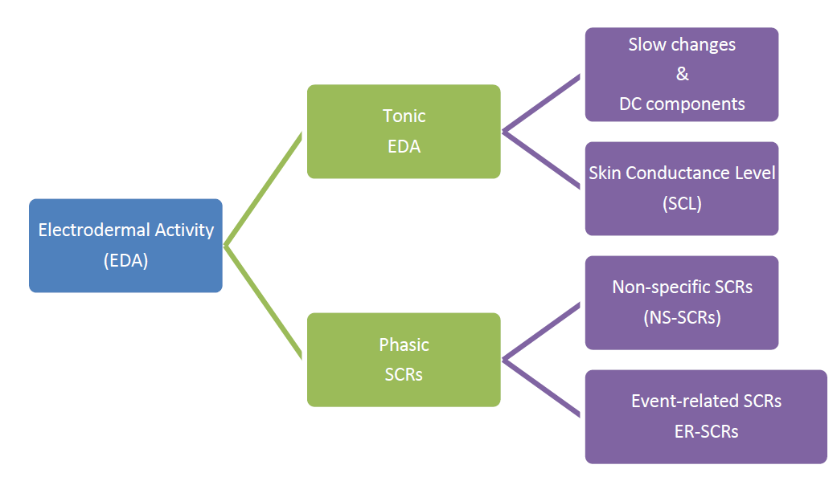
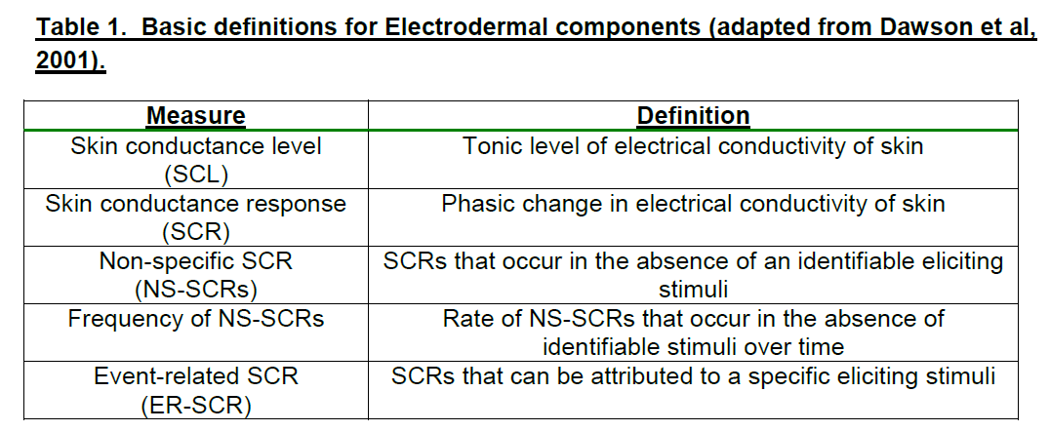
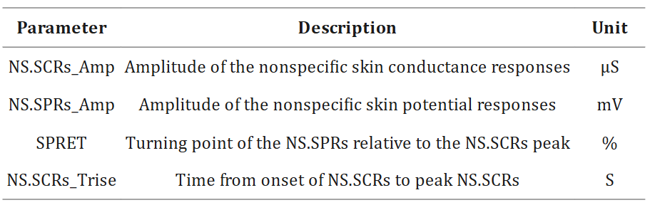
Electrodermal activity (EDA) for monitoring changes in electrical
conductance of the skin
Amplitudes, rise time(i.e., onset-to-peak time),
SCL score, Proportion of Maximal Response,
Low-frequency power.
Notes:
Electrodermal Activity (EDA): Measures the electrical conductance of the skin, which varies with sweat gland activity. Useful for assessing stress and emotional responses3
The electrodermal activity (EDA) signal is an electrical manifestation of the sympathetic innervation of the sweat glands. EDA has a history in psychophysiological (including emotional or cognitive stress) research since 1879, but it was not until recent years that researchers began using EDA for pathophysiological applications like the assessment of fatigue, pain, sleepiness, exercise recovery, diagnosis of epilepsy, neuropathies, depression, and so forth.
Occurrence of skin conductance responses (SCRs) resulting from an underlying sympathetic reaction to a stimulus.
Measures of the SCRs are used to evaluate a subject’s response to event-related experiments
(“startle-like” stimuli) or tonic stimuli tests (like a change in condition, workload, cognitive stress,
and so forth). Also have an event-related SCRs (ERSCRs).

Slide 26
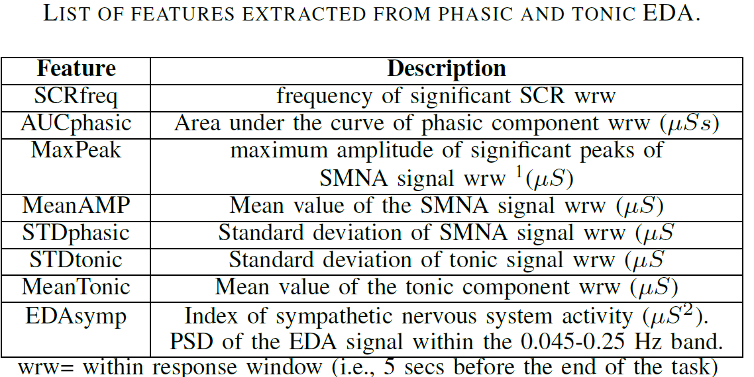
Electrodermal activity (EDA) for monitoring changes in electrical
conductance of the skin
Notes:
Electrodermal Activity (EDA): Measures the electrical conductance of the skin, which varies with sweat gland activity. Useful for assessing stress and emotional responses3
The electrodermal activity (EDA) signal is an electrical manifestation of the sympathetic innervation of the sweat glands. EDA has a history in psychophysiological (including emotional or cognitive stress) research since 1879, but it was not until recent years that researchers began using EDA for pathophysiological applications like the assessment of fatigue, pain, sleepiness, exercise recovery, diagnosis of epilepsy, neuropathies, depression, and so forth.
Occurrence of skin conductance responses (SCRs) resulting from an underlying sympathetic reaction to a stimulus.
Measures of the SCRs are used to evaluate a subject’s response to event-related experiments
(“startle-like” stimuli) or tonic stimuli tests (like a change in condition, workload, cognitive stress,
and so forth). Also have an event-related SCRs (ERSCRs).

Slide 27
Respiratory Signals for fatigue monitoring
Respiratory Rate (RR): The number of breaths taken per minutes. Changes in respiratory rate can indicate levels of physical exertion and fatigue.
Tidal Volume (TV): the amount of air inhaled or exhaled during a normal breath. Variations in tidal volume can reflect changes in respiratory effort and fatigue.
Minute Ventilation (MV): The total volume of air breathed in one minute. It combines respiratory rate and tidal volume, providing a comprehensive measure of respiratory function
Respiratory Muscle Activity: Measured using surface electromyography (sMEG) to assess the electrical activity of respirator muscles. This can help evaluate muscle fatigue and respiratory effort.
Notes:
Electrodermal Activity (EDA): Measures the electrical conductance of the skin, which varies with sweat gland activity. Useful for assessing stress and emotional responses3
Respiratory Signals: Can be measured using various methods, including respiratory inductance plethysmography or wearable sensors. Important for monitoring breathing patterns and detecting respiratory issues1
Oxygen Analyzer: Measures the concentration of oxygen in the blood. Critical for assessing respiratory efficiency and detecting conditions like hypoxemia3

Slide 28


ABOUT ME: Education & career background
Aim to applying digital techniques to healthcare
Sept 2023 – Present
Second MSc in
Statistics & Data Science
Sept 2013 – Jun 2017
Sept 2017 – Aug 2020
Sept 2020 – Present
BSc in
Rehabilitation Therapy
MSc in
Neurobiology
PhD in
Cognitive Neuroscience
University of Electronic
Science and Technology
of China
Southern Medical University
Leiden University
Leiden University
Intern in Guangdong Work Injury Rehabilitation Hospital
Research Consultant
Jun 2016 – May 2017
Mar 2020 – Sept 2020

Slide 29

Traditional experimental approach to study syntactic features: PWI
Picture-word Interference (PWI)
Conceptual
level
Activation of syntactic feature
is signatured by
Less negative N400/more positive P600
Absence of behavioral effect
CAT
Lemma
level
Syntactic
feature
Syntactic feature
congruent vs. incongruent
Phonological
word-form
Wang et al., (2019); Wang et al., (2024); .
Notes:
In speech production, speakers need to activate and select appropriate lexico-syntactic
features of words to plan grammatically correct sentences. Previous studies have focused on situations where a single option for lexico-syntactic features is grammatically correct, such as the grammatical gender of nouns in some Indo-European languages. However, there are cases in which multiple options of lexico-syntactic features are grammatically correct. One such case is Mandarin Chinese classifiers, where a given noun may take more
than one classifier. However, studies have simplified these cases to dichotomous situations
where only the dominant Mandarin Chinese classifier of a given noun was presumed to be
correct. In the current study, we asked native Mandarin Chinese speakers to name target
pictures using a picture-word interference paradigm. Distractor words with varying degrees
of classifier distribution similarity were superimposed while controlling for dominant
classifier congruency. Distractors with dissimilar classifier distributions resulted in a larger
P600 effect, but no behavioral effect was observed, compared to distractor nouns having
similar classifier distributions. Based on this result, we propose that, when producing a bare
noun, multiple compatible classifiers are activated at the lexical level with the degree of
activation being determined by their corresponding compatibility with the given noun.

Slide 30
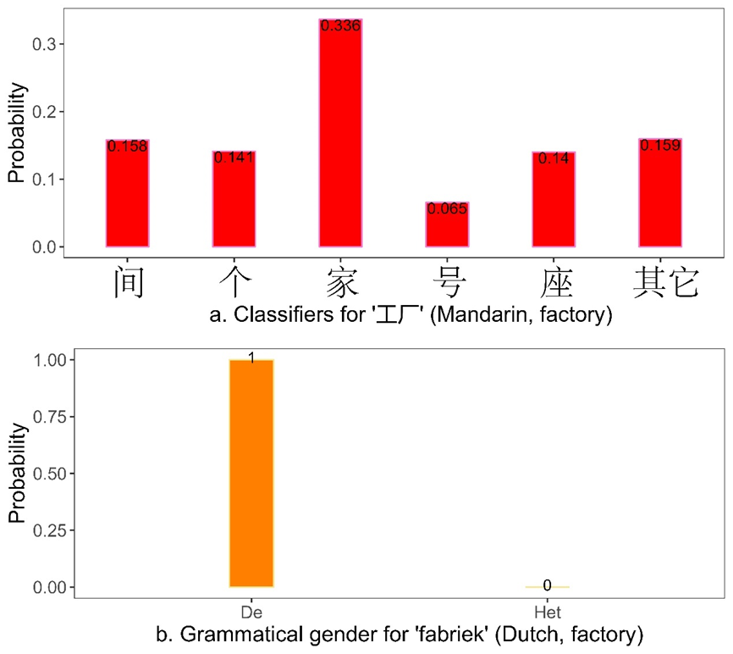
Experimental framework not aligned with Mandarin Chinese classifier
A noun has multiple correct options of Mandarin Chinese classifiers.
All classifiers for a noun can be represented as a probability distribution.
The probability distribution can be obtained via text mining
Notes:
In speech production, speakers need to activate and select appropriate lexico-syntactic
features of words to plan grammatically correct sentences. Previous studies have focused on situations where a single option for lexico-syntactic features is grammatically correct, such as the grammatical gender of nouns in some Indo-European languages. However, there are cases in which multiple options of lexico-syntactic features are grammatically correct. One such case is Mandarin Chinese classifiers, where a given noun may take more
than one classifier. However, studies have simplified these cases to dichotomous situations
where only the dominant Mandarin Chinese classifier of a given noun was presumed to be
correct. In the current study, we asked native Mandarin Chinese speakers to name target
pictures using a picture-word interference paradigm. Distractor words with varying degrees
of classifier distribution similarity were superimposed while controlling for dominant
classifier congruency. Distractors with dissimilar classifier distributions resulted in a larger
P600 effect, but no behavioral effect was observed, compared to distractor nouns having
similar classifier distributions. Based on this result, we propose that, when producing a bare
noun, multiple compatible classifiers are activated at the lexical level with the degree of
activation being determined by their corresponding compatibility with the given noun.

Slide 31
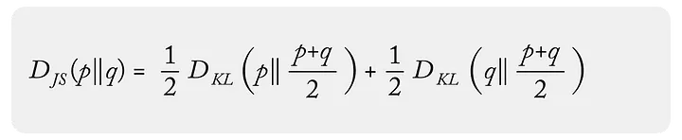
Replace congruency manipulation with JSD
EXPERIMENTAL PARADIGM: Picture-word Interference (PWI, updated version)
Syntactic feature congruent – Syntactic feature incongruent
update
Classifier probability distribution similar (D+) –
Classifier probability distribution dissimilar (D-)
Similar/dissimilar is measured by the JSD value:
CAT
Syntactic feature
congruent vs. incongruent
Notes:
In speech production, speakers need to activate and select appropriate lexico-syntactic
features of words to plan grammatically correct sentences. Previous studies have focused on situations where a single option for lexico-syntactic features is grammatically correct, such as the grammatical gender of nouns in some Indo-European languages. However, there are cases in which multiple options of lexico-syntactic features are grammatically correct. One such case is Mandarin Chinese classifiers, where a given noun may take more
than one classifier. However, studies have simplified these cases to dichotomous situations
where only the dominant Mandarin Chinese classifier of a given noun was presumed to be
correct. In the current study, we asked native Mandarin Chinese speakers to name target
pictures using a picture-word interference paradigm. Distractor words with varying degrees
of classifier distribution similarity were superimposed while controlling for dominant
classifier congruency. Distractors with dissimilar classifier distributions resulted in a larger
P600 effect, but no behavioral effect was observed, compared to distractor nouns having
similar classifier distributions. Based on this result, we propose that, when producing a bare
noun, multiple compatible classifiers are activated at the lexical level with the degree of
activation being determined by their corresponding compatibility with the given noun.

Slide 32
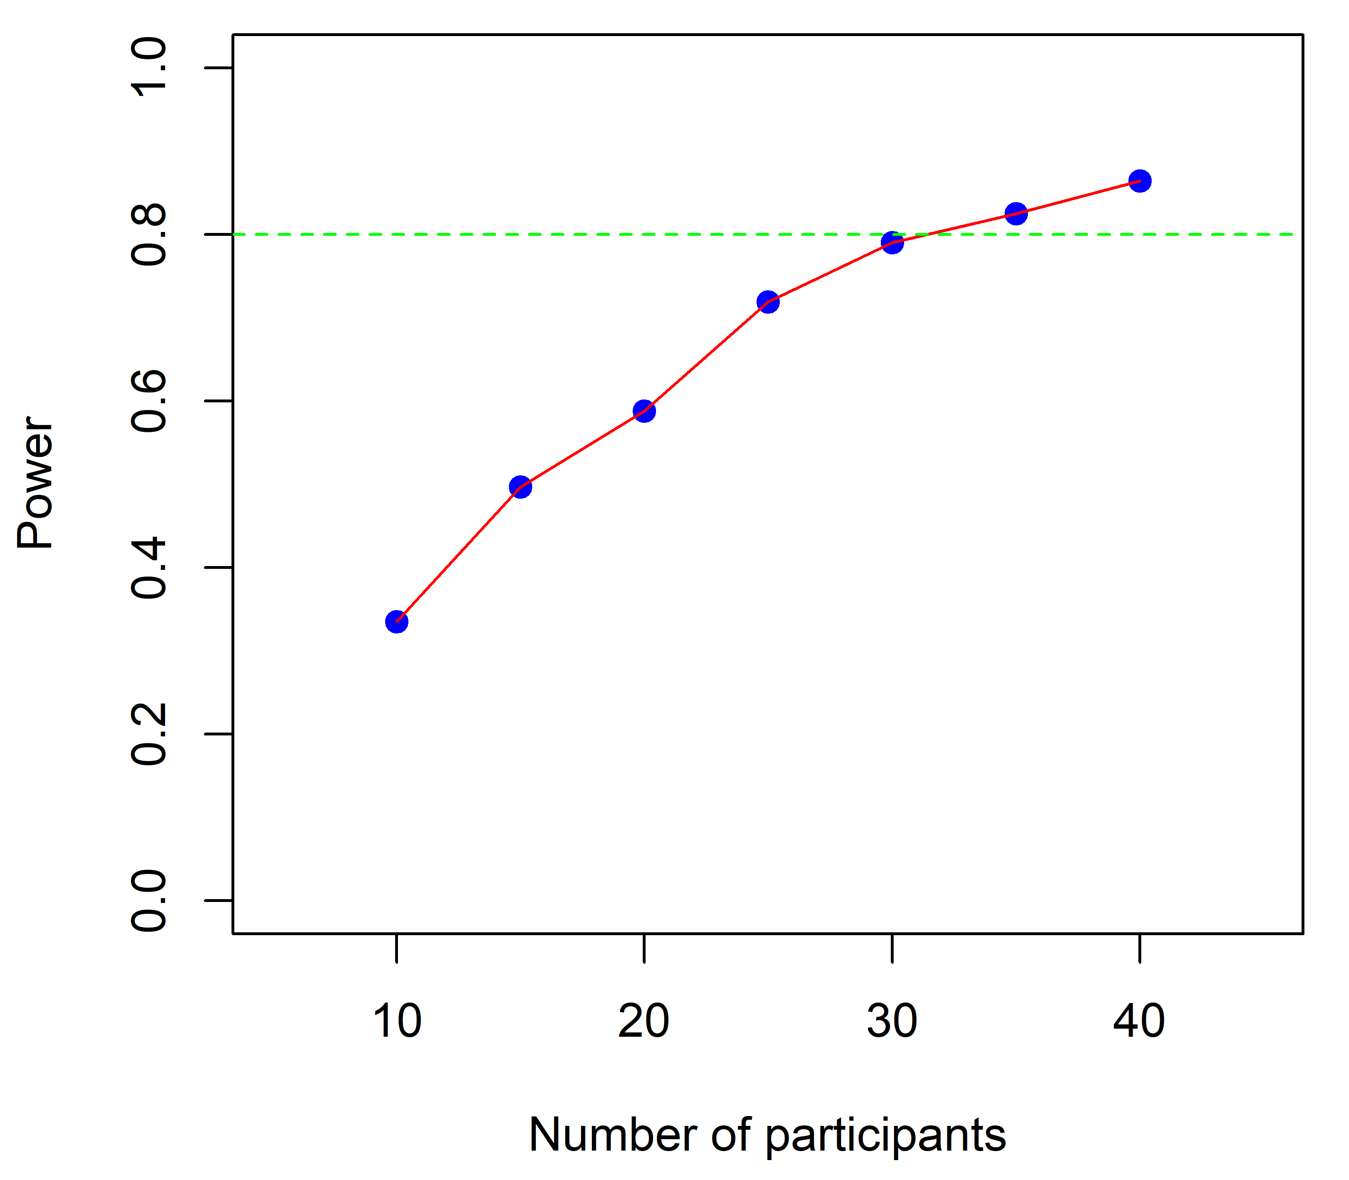
Determine the sample size based on stimulated power analysis
CAT
?
Sample size
D+ vs. D-
Fully-crossed experimental unit structure
 | Picture 1 | Picture 2 | … | Picture M
Subject 1 | D+, D- | D+, D- | .. | D+, D-
Subject 2 | D+, D- | … | … | D+, D-
… | … | … | … | D+, D-
Subject n | D+, D- | D+, D- | … | D+, D-
Example of power analysis
over number of participants
Notes:
In speech production, speakers need to activate and select appropriate lexico-syntactic
features of words to plan grammatically correct sentences. Previous studies have focused on situations where a single option for lexico-syntactic features is grammatically correct, such as the grammatical gender of nouns in some Indo-European languages. However, there are cases in which multiple options of lexico-syntactic features are grammatically correct. One such case is Mandarin Chinese classifiers, where a given noun may take more
than one classifier. However, studies have simplified these cases to dichotomous situations
where only the dominant Mandarin Chinese classifier of a given noun was presumed to be
correct. In the current study, we asked native Mandarin Chinese speakers to name target
pictures using a picture-word interference paradigm. Distractor words with varying degrees
of classifier distribution similarity were superimposed while controlling for dominant
classifier congruency. Distractors with dissimilar classifier distributions resulted in a larger
P600 effect, but no behavioral effect was observed, compared to distractor nouns having
similar classifier distributions. Based on this result, we propose that, when producing a bare
noun, multiple compatible classifiers are activated at the lexical level with the degree of
activation being determined by their corresponding compatibility with the given noun.

Slide 33
(Generalized) mixed effect model for data analysis
EXPERIMENTAL DATA ANALYSIS: (generalized) linear mixed model
Data analysis for within-subject and within-picture experimental design (to test)
Shmueli, G. (2010).
1. Generalized Linear mixed model for behavioral data
(an example):
2. Linear mixed model for electrophysiological data
(an example):
ERP_model = lmer(Electrophysiological feature ~ JSD + (1|SubjID) + (1|TargetID), family = Gamma(link="identity"))
Latency_model = glmer(Naming latencies ~ JSD + (1|SubjID) + (1|TargetID), family = Gamma(link="identity"))
Amplitudes
(one amplitude at each combination of time point and electrode)
FWER (permutation-based threshold-free cluster enchantment (TFCE) method)
Notes:
In speech production, speakers need to activate and select appropriate lexico-syntactic
features of words to plan grammatically correct sentences. Previous studies have focused on situations where a single option for lexico-syntactic features is grammatically correct, such as the grammatical gender of nouns in some Indo-European languages. However, there are cases in which multiple options of lexico-syntactic features are grammatically correct. One such case is Mandarin Chinese classifiers, where a given noun may take more
than one classifier. However, studies have simplified these cases to dichotomous situations
where only the dominant Mandarin Chinese classifier of a given noun was presumed to be
correct. In the current study, we asked native Mandarin Chinese speakers to name target
pictures using a picture-word interference paradigm. Distractor words with varying degrees
of classifier distribution similarity were superimposed while controlling for dominant
classifier congruency. Distractors with dissimilar classifier distributions resulted in a larger
P600 effect, but no behavioral effect was observed, compared to distractor nouns having
similar classifier distributions. Based on this result, we propose that, when producing a bare
noun, multiple compatible classifiers are activated at the lexical level with the degree of
activation being determined by their corresponding compatibility with the given noun.

Slide 34
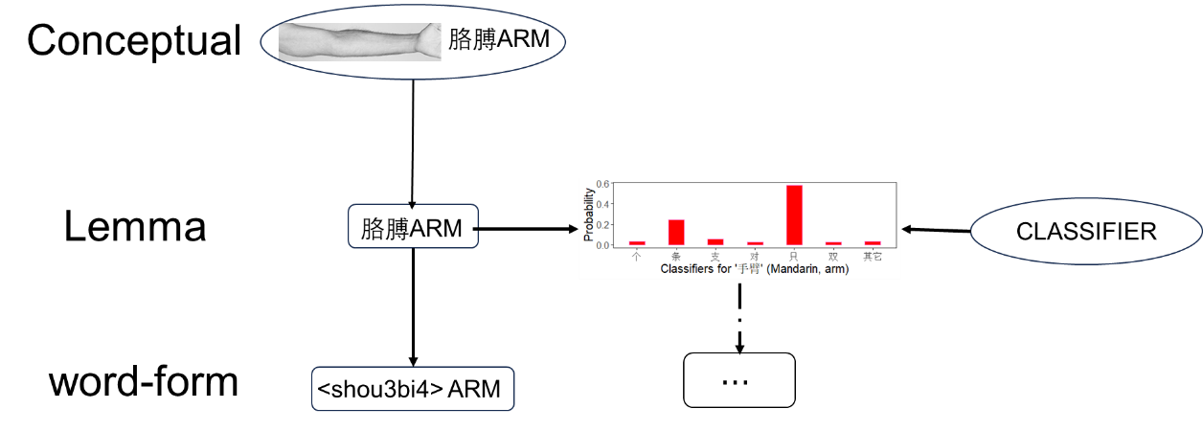
All classifiers are activated in word production
A larger P600 effect,
but no behavioral effect
for D+ vs. D-.
When producing a bare noun, multiple compatible classifiers are activated at the lexical level with the degree of activation being determined by their corresponding compatibility with the given noun.
Notes:
In speech production, speakers need to activate and select appropriate lexico-syntactic
features of words to plan grammatically correct sentences. Previous studies have focused on situations where a single option for lexico-syntactic features is grammatically correct, such as the grammatical gender of nouns in some Indo-European languages. However, there are cases in which multiple options of lexico-syntactic features are grammatically correct. One such case is Mandarin Chinese classifiers, where a given noun may take more
than one classifier. However, studies have simplified these cases to dichotomous situations
where only the dominant Mandarin Chinese classifier of a given noun was presumed to be
correct. In the current study, we asked native Mandarin Chinese speakers to name target
pictures using a picture-word interference paradigm. Distractor words with varying degrees
of classifier distribution similarity were superimposed while controlling for dominant
classifier congruency. Distractors with dissimilar classifier distributions resulted in a larger
P600 effect, but no behavioral effect was observed, compared to distractor nouns having
similar classifier distributions. Based on this result, we propose that, when producing a bare
noun, multiple compatible classifiers are activated at the lexical level with the degree of
activation being determined by their corresponding compatibility with the given noun.

Slide 35
Similar techniques being applied to the following works
• Wang, Y., Witteman, J., & Schiller, N. O. (2024). The role of animacy in language production: evidence from bare noun naming. Quarterly Journal of Experimental Psychology, 17470218241281868. https://doi.org/10.1177/17470218241281868.
• Wang, Y., Witteman, J., & Schiller, N. O. (2025). Activation of classifiers in word production: insights from lexico-syntactic probability distributions. Language, Cognition and Neuroscience. Revising.
• Wang, Y., Witteman, J., & Schiller, N. O. (2025). Semantic interference in language production is not solely driven by semantic features. Submitted.
Notes:
In speech production, speakers need to activate and select appropriate lexico-syntactic
features of words to plan grammatically correct sentences. Previous studies have focused on situations where a single option for lexico-syntactic features is grammatically correct, such as the grammatical gender of nouns in some Indo-European languages. However, there are cases in which multiple options of lexico-syntactic features are grammatically correct. One such case is Mandarin Chinese classifiers, where a given noun may take more
than one classifier. However, studies have simplified these cases to dichotomous situations
where only the dominant Mandarin Chinese classifier of a given noun was presumed to be
correct. In the current study, we asked native Mandarin Chinese speakers to name target
pictures using a picture-word interference paradigm. Distractor words with varying degrees
of classifier distribution similarity were superimposed while controlling for dominant
classifier congruency. Distractors with dissimilar classifier distributions resulted in a larger
P600 effect, but no behavioral effect was observed, compared to distractor nouns having
similar classifier distributions. Based on this result, we propose that, when producing a bare
noun, multiple compatible classifiers are activated at the lexical level with the degree of
activation being determined by their corresponding compatibility with the given noun.

Slide 36
Master-level projects:

Slide 37
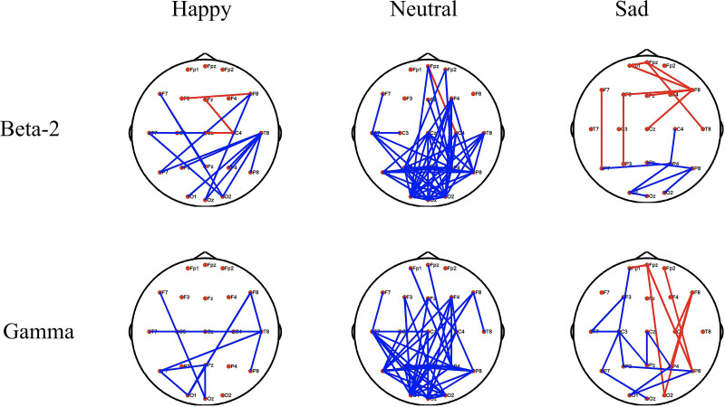
Sad music modulates pain perception (Master thesis: China)
Guo, S., Lu, J., Wang, Y., Li, Y., Huang, B., Zhang, Y., ... & Xia, Y. (2020). Sad music modulates pain perception:
an EEG study. Journal of pain research, 2003-2012. (China, Master work)
Design experimental protocol for stimulated pain
Perform the approved experiment
Frequency analysis and network analysis

Slide 38
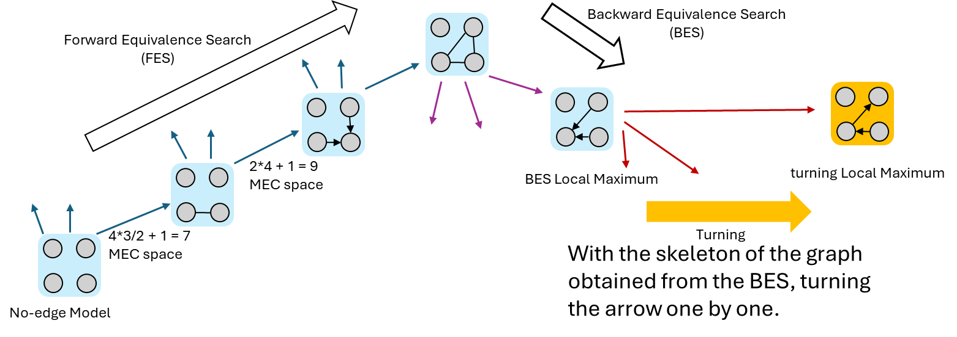
Score based causal structural learning (Master coursework: Netherlands)
Score based causal structural learning: a tutorial of GIES (Netherlands, Second master work)
Applied Greedy Intervention Equivalence Search to mini the underlying causal structural for both
observational and interventional data.
Write up the tutorial for this method to communicate with internal stakeholders.
Finalized the project with 8/10.

Slide 39
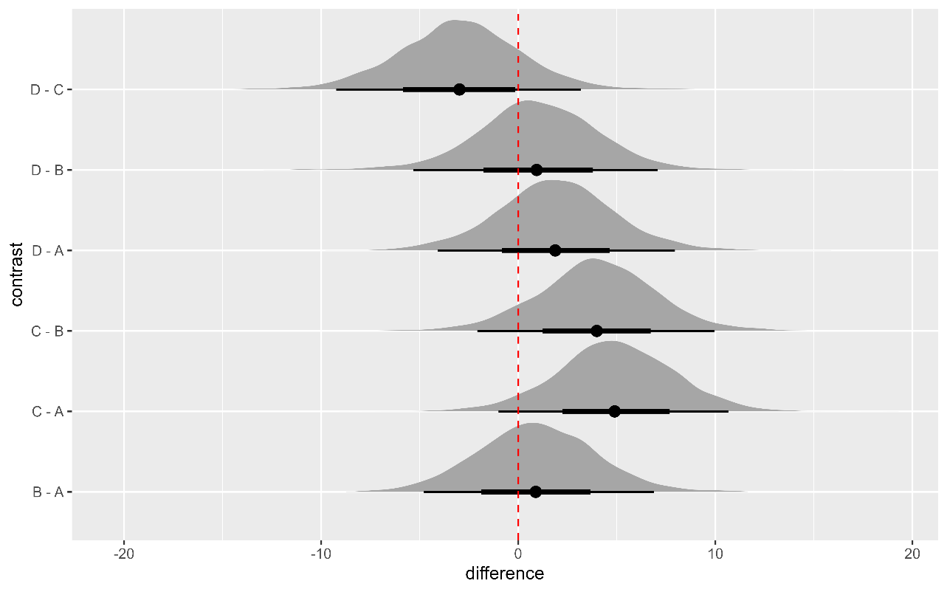
Bayesian linear modelling (Master coursework: Netherlands)
Bayesian linear modelling | R, brms, ggplot2, dplyrm ggdist, bayesplot, tidybayes, emmeans
Applied bayesian linear modelling to analysis experimental data
Write up the report for to communicate results.
Finalized the project with 8.5/10.

Slide 40
“Smart” House forecasting (Master coursework: Netherlands)
“Smart” House forecasting | Python, Numpy, Pandas, Matplotlib, Seaborn, SciKit-Learn, Git, & SQL
Data Analysis & Visualization: Built tools to automatically collected, analyzed, and visualized sensor data via Python, NumPy, Pandas, Matplotlib, Seaborn
Database Management: Designed and maintained SQL databases for efficient data storage and retrieval.
Automation & Optimization: Implemented ridge regression algorithms to automate home management tasks and used Git for version control.
Achieved 8.5/10 grading by the internal stakeholders

Slide 41
Type of data I have hands-on experience with
Time-to-event data
(f)MRI data
EEG data
survey data
behavioral data
Language data.

Slide 42
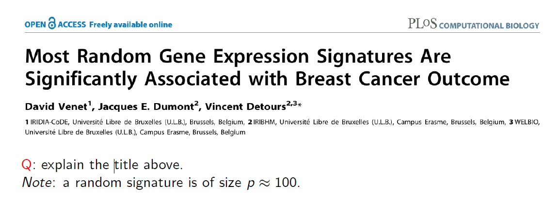

Slide 44
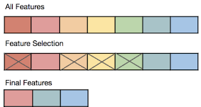



PROJECT 2: Bayesian Network Learning for feature selection
What if the literature did not give explicit electrophysiological features
EEG FEATURES
THEORIES
Algorithm
Time/frequency domain
time-frequency domain
features
Direct acyclic graph (DAG)
Bayesian rule
Score-based Bayesian
network learning
(GIES)

Slide 45
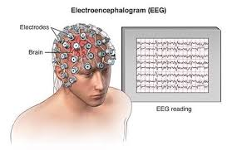
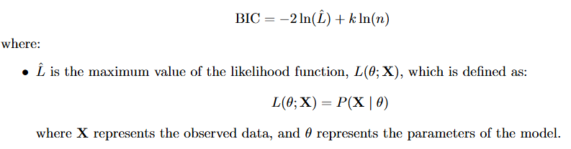
PROJECT 2: Bayesian Network Learning for feature selection
EEG FEATURE DEFINING
1. Transform the time-domain signals into the frequency domain
2. Get random variables
3. Find a DAG that can represent the underlying structure of the data best
(Directed Acyclic Graph)
Assumptions:
(1) Causal Faithfulness; (2) Acyclic DAG;
(3) Causal Markov Assumption; (4) Causal sufficiency:
Not testable for real-world data;
Best:
quantify by score function (i.e., BIC here)
Underlying structure:
factorizing the P(X)based on a DAG

Slide 46
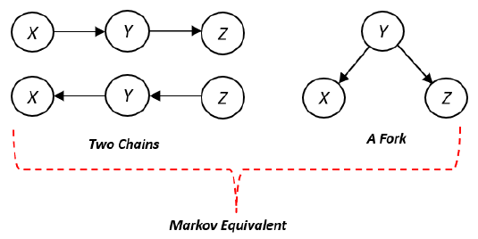
PROJECT 2: Bayesian Network Learning for feature selection
REACH CONSISTENCY for BIC & DAG
Do BIC and P(X) have one-on-one relationship?
NO
P(x, y, z) = P(z|y)P(y|x)P(x)
chain rule: P(x|y)P(y) = P(y|x)P(x)

Slide 47
PROJECT 2: Bayesian Network Learning for feature selection
PROCEDURE OF GIES
Backward Equivalence Search
(BES)
Forward Equivalence Search
(FES)
2*4 + 1 = 9
MEC space
BES Local Maximum
turning Local Maximum
4*3/2 + 1 = 7
MEC space
Turning
With the skeleton of the graph obtained from the BES, turning the arrow one by one.
No-edge Model

Slide 48
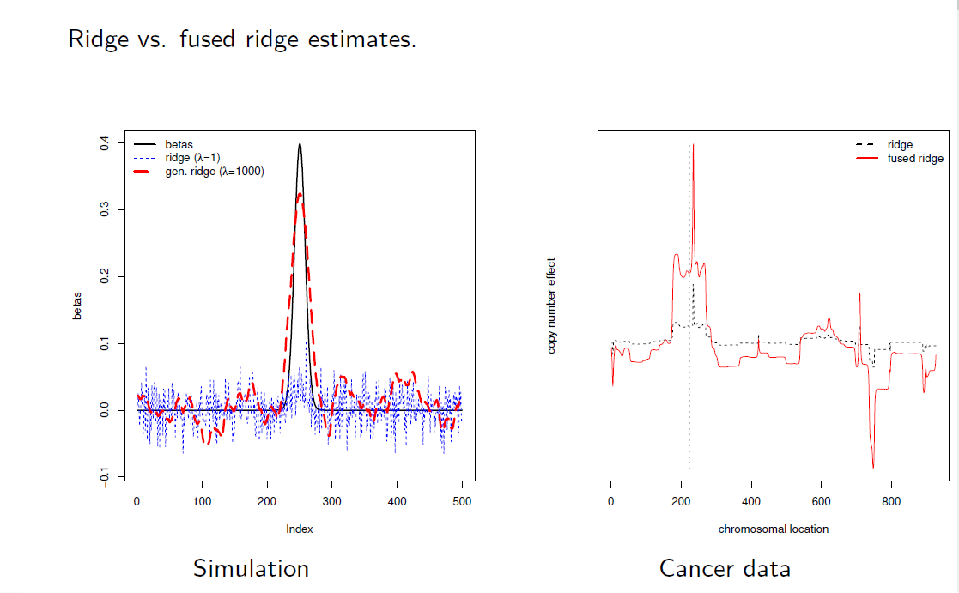
PROJECT 2: Bayesian Network Learning for feature selection
RESULT OF GIES

Slide 49




Activation of Mandarin Chinese classifiers in word production
Aim to generalize existing language production model to the case of Mandarin Chinese classifiers
SYNTACTIC FEATURE
THEORIES
EXPERIMENTS
Their role in
language production
Levelt’s model
Picture-word
Interference
Notes:
In speech production, speakers need to activate and select appropriate lexico-syntactic
features of words to plan grammatically correct sentences. Previous studies have focused on situations where a single option for lexico-syntactic features is grammatically correct, such as the grammatical gender of nouns in some Indo-European languages. However, there are cases in which multiple options of lexico-syntactic features are grammatically correct. One such case is Mandarin Chinese classifiers, where a given noun may take more
than one classifier. However, studies have simplified these cases to dichotomous situations
where only the dominant Mandarin Chinese classifier of a given noun was presumed to be
correct. In the current study, we asked native Mandarin Chinese speakers to name target
pictures using a picture-word interference paradigm. Distractor words with varying degrees
of classifier distribution similarity were superimposed while controlling for dominant
classifier congruency. Distractors with dissimilar classifier distributions resulted in a larger
P600 effect, but no behavioral effect was observed, compared to distractor nouns having
similar classifier distributions. Based on this result, we propose that, when producing a bare
noun, multiple compatible classifiers are activated at the lexical level with the degree of
activation being determined by their corresponding compatibility with the given noun.

Slide 50
PROJECT 3: Feature synthesis in prediction

Slide 51
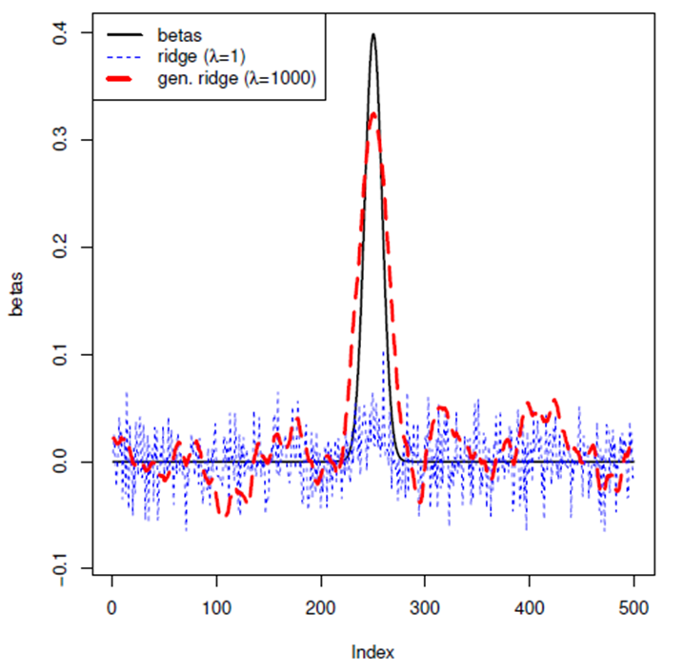
PROJECT 3: Feature synthesis in prediction
What if we want to find the biomarkers of certain stage of language production
EEG FEATURES
CONSTRINST
Algorithm
Time/frequency domain
time-frequency domain
features
Time & space

Slide 52
PROJECT 1: Activation of classifiers in word production
The role
SYNTACTIC FEATURE
THEORIES
EXPERIMENTS
Grammatical gender,
Mandarin Chinese
classifiers
Levelt’s model
Picture-word
Interference
Notes:
In speech production, speakers need to activate and select appropriate lexico-syntactic
features of words to plan grammatically correct sentences. Previous studies have focused on situations where a single option for lexico-syntactic features is grammatically correct, such as the grammatical gender of nouns in some Indo-European languages. However, there are cases in which multiple options of lexico-syntactic features are grammatically correct. One such case is Mandarin Chinese classifiers, where a given noun may take more
than one classifier. However, studies have simplified these cases to dichotomous situations
where only the dominant Mandarin Chinese classifier of a given noun was presumed to be
correct. In the current study, we asked native Mandarin Chinese speakers to name target
pictures using a picture-word interference paradigm. Distractor words with varying degrees
of classifier distribution similarity were superimposed while controlling for dominant
classifier congruency. Distractors with dissimilar classifier distributions resulted in a larger
P600 effect, but no behavioral effect was observed, compared to distractor nouns having
similar classifier distributions. Based on this result, we propose that, when producing a bare
noun, multiple compatible classifiers are activated at the lexical level with the degree of
activation being determined by their corresponding compatibility with the given noun.

Slide 53

PROJECT 1: Activation of classifiers in word production
Aim to investigate the encoding of Mandarin Chinese in the human mind
SYNTACTIC FEATURE
THEORIES
EXPERIMENTS
SOULTIONS
Notes:
In speech production, speakers need to activate and select appropriate lexico-syntactic
features of words to plan grammatically correct sentences. Previous studies have focused on situations where a single option for lexico-syntactic features is grammatically correct, such as the grammatical gender of nouns in some Indo-European languages. However, there are cases in which multiple options of lexico-syntactic features are grammatically correct. One such case is Mandarin Chinese classifiers, where a given noun may take more
than one classifier. However, studies have simplified these cases to dichotomous situations
where only the dominant Mandarin Chinese classifier of a given noun was presumed to be
correct. In the current study, we asked native Mandarin Chinese speakers to name target
pictures using a picture-word interference paradigm. Distractor words with varying degrees
of classifier distribution similarity were superimposed while controlling for dominant
classifier congruency. Distractors with dissimilar classifier distributions resulted in a larger
P600 effect, but no behavioral effect was observed, compared to distractor nouns having
similar classifier distributions. Based on this result, we propose that, when producing a bare
noun, multiple compatible classifiers are activated at the lexical level with the degree of
activation being determined by their corresponding compatibility with the given noun.

Slide 54
PROJECT 1: Activation of classifiers in word production
Aim to investigate the encoding of Mandarin Chinese in the human mind
SYNTACTIC FEATURE
THEORIES
EXPERIMENTS
SOULTIONS
Notes:
In speech production, speakers need to activate and select appropriate lexico-syntactic
features of words to plan grammatically correct sentences. Previous studies have focused on situations where a single option for lexico-syntactic features is grammatically correct, such as the grammatical gender of nouns in some Indo-European languages. However, there are cases in which multiple options of lexico-syntactic features are grammatically correct. One such case is Mandarin Chinese classifiers, where a given noun may take more
than one classifier. However, studies have simplified these cases to dichotomous situations
where only the dominant Mandarin Chinese classifier of a given noun was presumed to be
correct. In the current study, we asked native Mandarin Chinese speakers to name target
pictures using a picture-word interference paradigm. Distractor words with varying degrees
of classifier distribution similarity were superimposed while controlling for dominant
classifier congruency. Distractors with dissimilar classifier distributions resulted in a larger
P600 effect, but no behavioral effect was observed, compared to distractor nouns having
similar classifier distributions. Based on this result, we propose that, when producing a bare
noun, multiple compatible classifiers are activated at the lexical level with the degree of
activation being determined by their corresponding compatibility with the given noun.

Slide 55
PROJECT 1: Activation of classifiers in word production
Aim to investigate the encoding of Mandarin Chinese in the human mind
SYNTACTIC FEATURE
Notes:
In speech production, speakers need to activate and select appropriate lexico-syntactic
features of words to plan grammatically correct sentences. Previous studies have focused on situations where a single option for lexico-syntactic features is grammatically correct, such as the grammatical gender of nouns in some Indo-European languages. However, there are cases in which multiple options of lexico-syntactic features are grammatically correct. One such case is Mandarin Chinese classifiers, where a given noun may take more
than one classifier. However, studies have simplified these cases to dichotomous situations
where only the dominant Mandarin Chinese classifier of a given noun was presumed to be
correct. In the current study, we asked native Mandarin Chinese speakers to name target
pictures using a picture-word interference paradigm. Distractor words with varying degrees
of classifier distribution similarity were superimposed while controlling for dominant
classifier congruency. Distractors with dissimilar classifier distributions resulted in a larger
P600 effect, but no behavioral effect was observed, compared to distractor nouns having
similar classifier distributions. Based on this result, we propose that, when producing a bare
noun, multiple compatible classifiers are activated at the lexical level with the degree of
activation being determined by their corresponding compatibility with the given noun.

Slide 56
PROJECT 1: Activation of classifiers in word production
Aim to investigate the encoding of Mandarin Chinese in the human mind
activate and select appropriate lexico-syntactic features of words.
Previous studies have focused on situations where a single option for lexico-syntactic features is grammatically correct, such as the grammatical gender of nouns in some Indo-European languages.
However, there are cases in which multiple options of lexico-syntactic features are grammatically correct
Notes:
In speech production, speakers need to activate and select appropriate lexico-syntactic
features of words to plan grammatically correct sentences. Previous studies have focused on situations where a single option for lexico-syntactic features is grammatically correct, such as the grammatical gender of nouns in some Indo-European languages. However, there are cases in which multiple options of lexico-syntactic features are grammatically correct. One such case is Mandarin Chinese classifiers, where a given noun may take more
than one classifier. However, studies have simplified these cases to dichotomous situations
where only the dominant Mandarin Chinese classifier of a given noun was presumed to be
correct. In the current study, we asked native Mandarin Chinese speakers to name target
pictures using a picture-word interference paradigm. Distractor words with varying degrees
of classifier distribution similarity were superimposed while controlling for dominant
classifier congruency. Distractors with dissimilar classifier distributions resulted in a larger
P600 effect, but no behavioral effect was observed, compared to distractor nouns having
similar classifier distributions. Based on this result, we propose that, when producing a bare
noun, multiple compatible classifiers are activated at the lexical level with the degree of
activation being determined by their corresponding compatibility with the given noun.

Slide 57
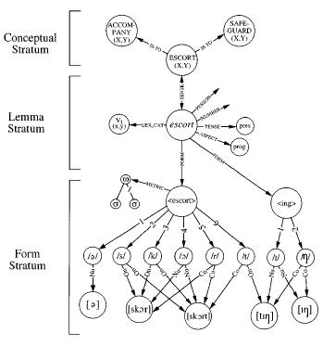
PROJECT 1: Activation of classifiers in word production
Aim to investigate the encoding of Mandarin Chinese in the human mind
Theoretical models of word production:
Lexicial-syntactic features, e.g., grammatic
gender in European languages, are encoded
at the lemma level of Levelt’s model.

Slide 58
My existing project 2: Bayesian network learning
Aim to find a DAG that can represent the underlying structure of data best
Msc in
Neurobiology
Leiden University

Slide 59
My existing project 1: insights from empirical perspective
Aim to br

Slide 60
My existing project 2: Bayesian network learning
Aim to br

Slide 61
Problem statement
Missing information:
What about word relationships that have not been studied yet?
What about the interaction between different word relationships?
Too many words to be tested on humans
Any alternative method that can be used to represent the word encoding directly?

Slide 62
Can we study the word relationships learned by a NN network instead?
Assumption 1:
Encoding of a word in the (human) brain is derived from their use in spoken and (especially) written language
If true:
Then the meaning/encoding of words can be obtained by studying word co-occurrence in written language
Assumption 2:
Potentially, the meaning/encoding of words are learned on large sets of text by artificial neural models
If true:
We can conduct our experiments on a neural network rather than a human

Slide 63
Which NN to study? > BERT
Compared to other NNs, BERT encoding has the following advantage:
Words with multiple meanings are encoded with multiple conceptual nodes
In other words, the high-dimensional vectors (represent the word encoding) that
BERT generates are more granular (contextual-based) than other NNs, which is
conceptually in line with how words are encoded in the human brain.

Slide 64
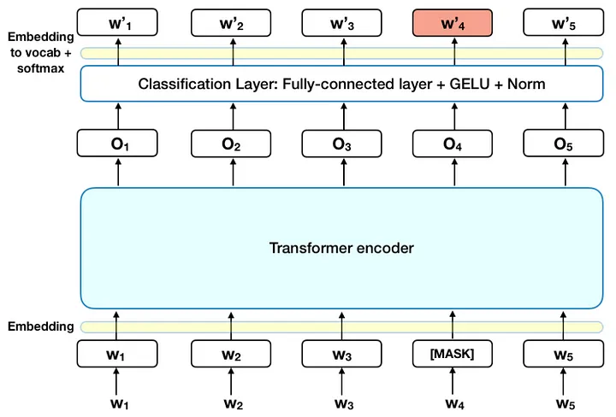
How the BERT model is trained

Slide 65
Studying the representation of words in a NN
Conceptual model:
Experimental
design:
Results:
(quantitative)
Conclusions:
(qualitative)
Relative distances
between word-pairs
in the semantic network
Determined
qualitatively through
comparative analysis
Obtain high
dimensional word
vectors from NN
Cosine distances

Slide 66
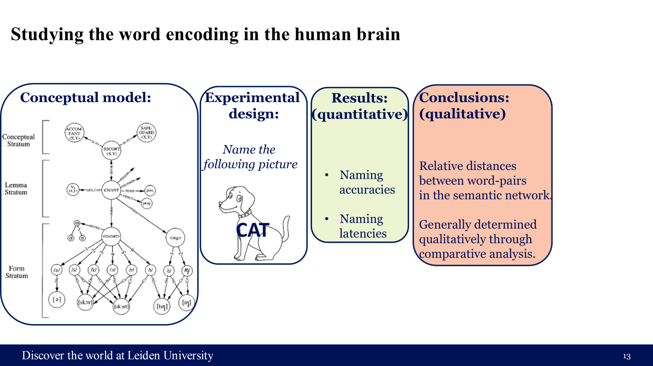
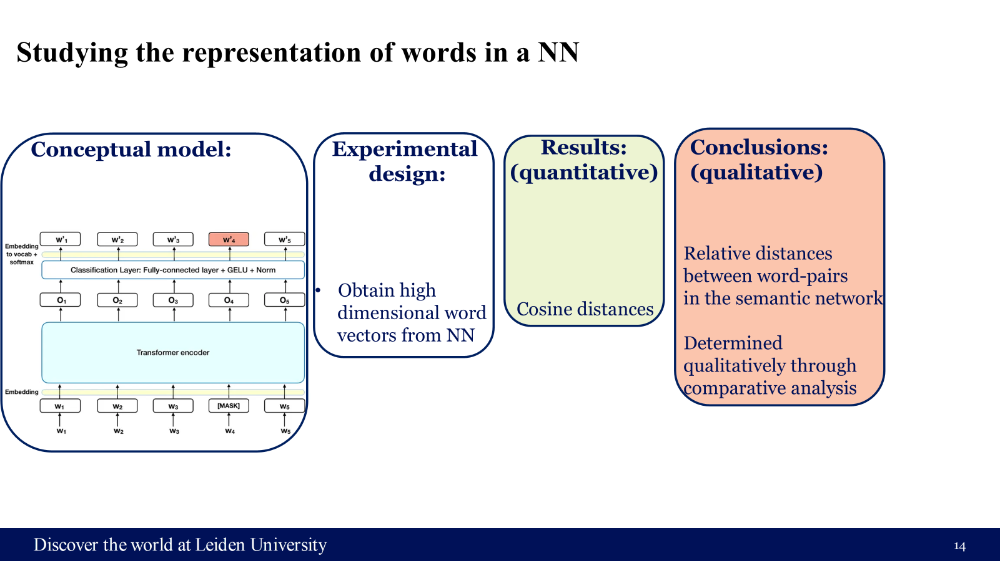
How to compare the representation of words between NN and human brain
Human experiment :
NN experiment :

Slide 67
Check consistency between NN and human brain
Technical realization :
Check the words summarized from (Bürki et al., 2020) to verify the organization of words from sematic category;
Check the words obtained from (De Zubicaray et al., 2018; Gauvin et al., 2019; Wang et al., 2024) to verify the organization of words from sematic features;
Check the prediction values of contextual embeddings in the naming latencies and naming accuracies.
To be verified criteria for BERT :
Existing qualitative findings should be reflected
Semantic category, semantic feature congruent words
are located closer than … ;
Existing quantitative results should be reflected.

Slide 68
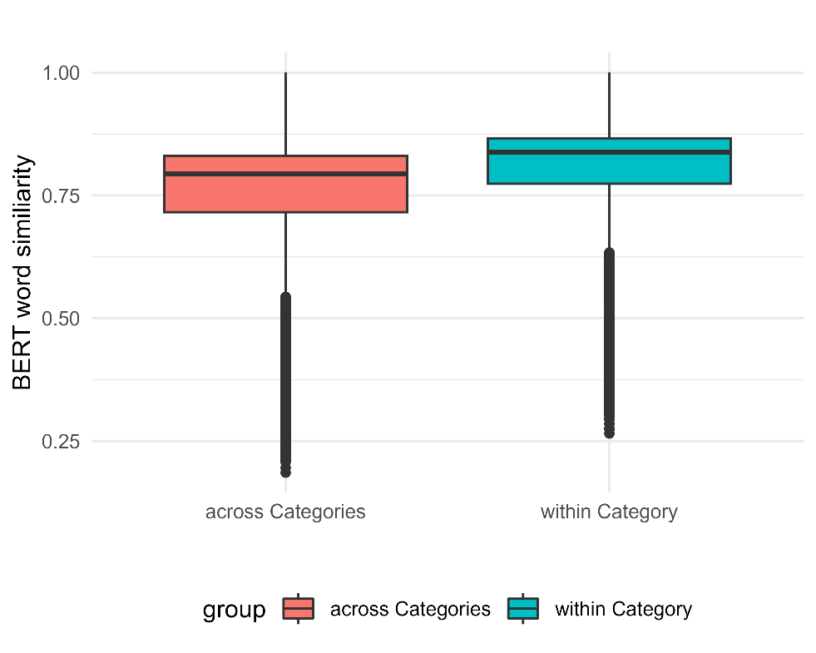
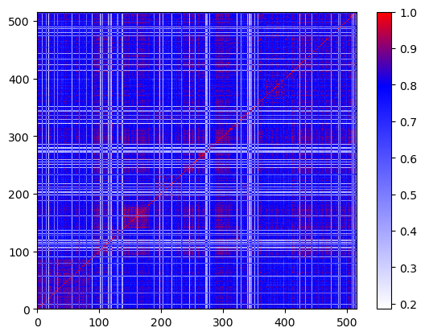
Check the words summarized from Check the words summarized from (Bürki et al., 2020) to verify the organization of words from sematic category;
Technical realization (a)
t = 25.50, df = 9919.2, p < 0.001

Slide 69
b. Check the words obtained from (De Zubicaray et al., 2018; Gauvin et al., 2019; Wang et al., 2024) to verify the organization of words from sematic features; c. Check the prediction values of contextual embeddings in the naming latencies and naming accuracies.
Technical realization (b&c)
On going …

Slide 70
Thanks for your attention!

Slide 71
Studying the representation of words in a NN
Conceptual model:
Experimental
design:
Results:
(quantitative)
Conclusions:
(qualitative)
Relative distances
between word-pairs
in the semantic network
Determined
qualitatively through
comparative analysis
Obtain high
dimensional word
vectors from NN
Cosine distances

Slide 72

To be-verified criteria for the potential alternative
Technically realization:
Get the words summarized from (Bürki et al., 2020) to verify the organization of words from sematic category;
Get the words obtained from (De Zubicaray et al., 2018; Gauvin et al., 2019; Wang et al., 2024) to verify the organization of words from sematic features;
Use the naming latencies and naming accuracies from PWI as response variables to verify the prediction values of contextual embeddings.

Slide 73

To be-verified criteria for the potential alternative
To be verified criteria for BERT:
Existing qualitative findings should be reflected
Semantic category, semantic feature congruent words
are located closer than … ;
Existing quantitative results should be reflected.
ON THIS MODEL
Technically realization:
Get the words summarized from (Bürki et al., 2020) to verify the organization of words from sematic category;
Get the words obtained from (De Zubicaray et al., 2018; Gauvin et al., 2019; Wang et al., 2024) to verify the organization of words from sematic features;
Use the naming latencies and naming accuracies from PWI as response variables to verify the prediction values of contextual embeddings.

Slide 74
Studying the word encoding in the human brain
Conceptual model:
Experimental
design:
Results:
(quantitative)
Conclusions:
(qualitative)
Name the
following picture
Relative distances
between word-pairs
in the semantic network.
Generally determined
qualitatively through
comparative analysis.
Naming
accuracies
Naming
latencies
CAT

Slide 75
Studying the representation of words in a NN
Conceptual model:
Experimental
design:
Results:
(quantitative)
Conclusions:
(qualitative)
Relative distances
between word-pairs
in the semantic network
Determined
qualitatively through
comparative analysis
Obtain high
dimensional word
vectors from NN
Cosine distances

Slide 76
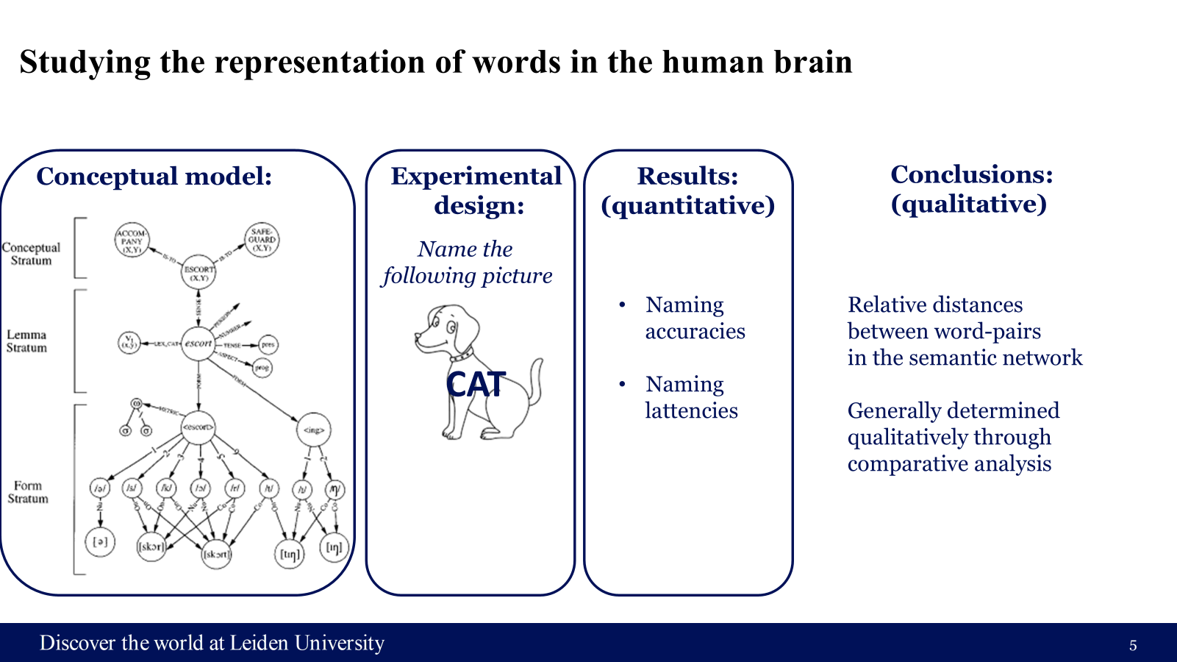
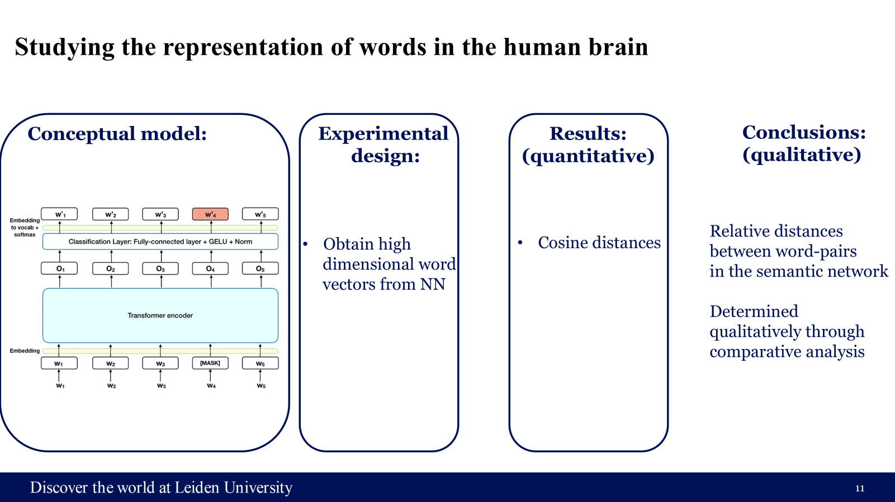
How to compare the representation of words between NN and human brain
Human experiment:
NN experiment:

